Slide 1

Abstractive Text Summarization
SAYAK DAS (RA2011026010101)
ROOPAL SOOD (RA2011026010103)
KESHAV HANDA (RA2011026010088)
Section – Q1

Slide 2


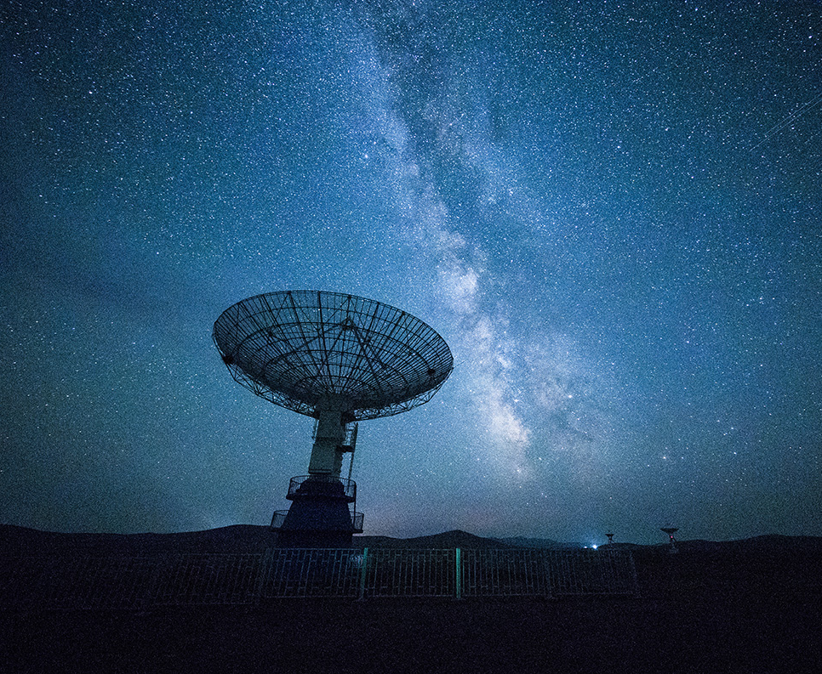
abstract
Abstractive text summarization is a Natural Language Processing (NLP) task that involves generating a summary of a given text that captures the most important and relevant information. Unlike extractive summarization, which selects and rephrases key sentences from the original text, abstractive summarization aims to generate new sentences that convey the meaning of the original text.
Abstractive summarization can be applied in various contexts, including news articles, scientific papers, legal documents, and social media posts. It requires advanced NLP techniques, such as natural language generation, machine learning, and deep learning, to generate coherent and informative summaries.

Slide 3
PROBLEM STATEMENT
The increasing amount of textual data available on the internet has created a need for automatic text summarization systems. While extractive summarization methods exist, they often lack coherence and do not capture the main ideas of the original text. Abstractive summarization methods aim to generate more coherent and informative summaries by rephrasing and paraphrasing the original text. The goal of this project is to develop an abstractive text summarization system using NLP techniques that can generate high-quality summaries of input text.

Slide 4
Limitations with citations:
Abstractive text summarization is a challenging task in natural language processing (NLP) that involves generating a concise and coherent summary of a longer document, while preserving its key information and meaning. Despite recent advances in NLP, abstractive summarization still faces several limitations.
One of the main limitations is the lack of large, high-quality training datasets. Abstractive summarization requires large amounts of human-annotated data to train the machine learning models, which is a time-consuming and expensive process. Currently available datasets are often small and biased towards certain domains or genres, making it difficult to generalize the models to other types of text.
Another limitation is the difficulty in capturing the nuances and subtleties of human language. Abstractive summarization models often struggle with correctly understanding the context and generating accurate summaries that capture the most important information. They may also introduce errors or distortions into the summary, leading to a loss of accuracy and coherence.

Slide 5
Objectives:
The main objective of abstractive text summarization using NLP is to generate a concise and coherent summary of a given text, while preserving its most important information and meaning. This is achieved by using natural language processing techniques to identify and extract the key concepts and ideas from the text, and then rephrasing and condensing them in a way that captures their essence.
More specifically, the objectives of abstractive text summarization using NLP can include:
Comprehensiveness: The summary should cover all the main points and ideas in the original text, while excluding irrelevant or redundant information.
Coherence: The summary should be well-structured and easy to understand, with clear connections between different ideas.
Conciseness: The summary should be short and to the point, without sacrificing the essential meaning of the original text.
Fluency: The summary should be written in natural and fluent language, with correct grammar and syntax.
Overall, the goal of abstractive text summarization using NLP is to provide a useful and effective tool for quickly summarizing large amounts of text.

Slide 6
Proposed Methodology:
BART (Bidirectional and Auto-Regressive Transformers) is a state-of-the-art sequence-to-sequence model that has been successfully used for abstractive text summarization.
The BART model is based on a transformer architecture, which uses self-attention mechanisms to capture the dependencies between the input and output sequences. The model consists of two components: an encoder and a decoder. The encoder reads the input text and produces a set of hidden representations, while the decoder uses these representations to generate the summary.
BART uses a pretraining method that combines denoising autoencoding and sequence-to-sequence pretraining objectives. During pretraining, the model is trained to reconstruct a corrupted version of the input text, and then to generate a target sequence given a source sequence. This approach has been shown to improve the quality of the model's representations and enable it to better capture long-term dependencies in the input text.
During fine-tuning for abstractive text summarization, the BART model is trained to generate a summary that captures the key information in the input text. The model is trained to minimize a loss function that measures the similarity between the generated summary and the reference summary.
Overall, BART has been shown to achieve state-of-the-art results on several benchmark datasets for abstractive text summarization, demonstrating the effectiveness of the model's pretraining method and transformer architecture.

Slide 7
Architecture Diagram:
+-----------+
| Input Text|
+-----------+
|
|
v
+-----------+
| Tokenizer |
+-----------+
|
|
v
+---------+
| Encoder |
+---------+
|
|
v
+---------+
| Decoder | ----------> Output summary
+---------+

Slide 8
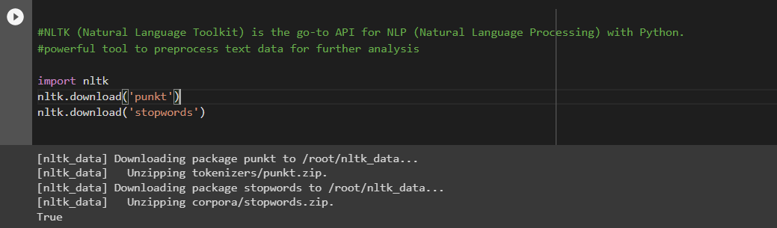
Preprocessing
NLTK (Natural Language Toolkit) is the goto API for NLP (Natural Language Processing)
with Python.
It is a powerful tool to preprocess text data for further analysis.
Re is a built-in python package which is used to work with regular expression.

Slide 9
BART:
BART: Bidirectional and Auto-Regressive Transformers
BART, a denoising autoencoder for pretraining sequence-to-sequence models. BART is trained by
(1) corrupting text with an arbitrary noising function
(2) learning a model to reconstruct the original text.
It uses a standard Tranformer-based neural machine translation architecture which, despite its simplicity, can be seen as generalizing BERT (due to the bidirectional encoder)

Slide 10
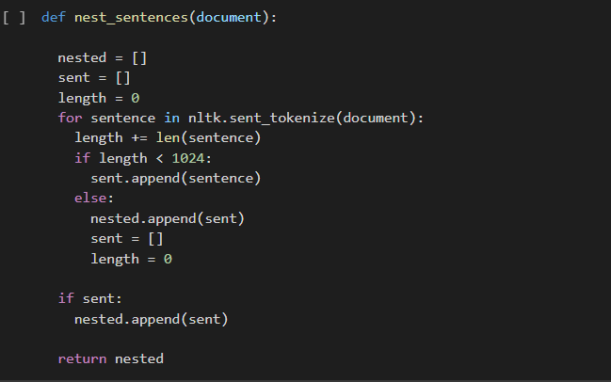
Build Function to process the chunk texts

Slide 11
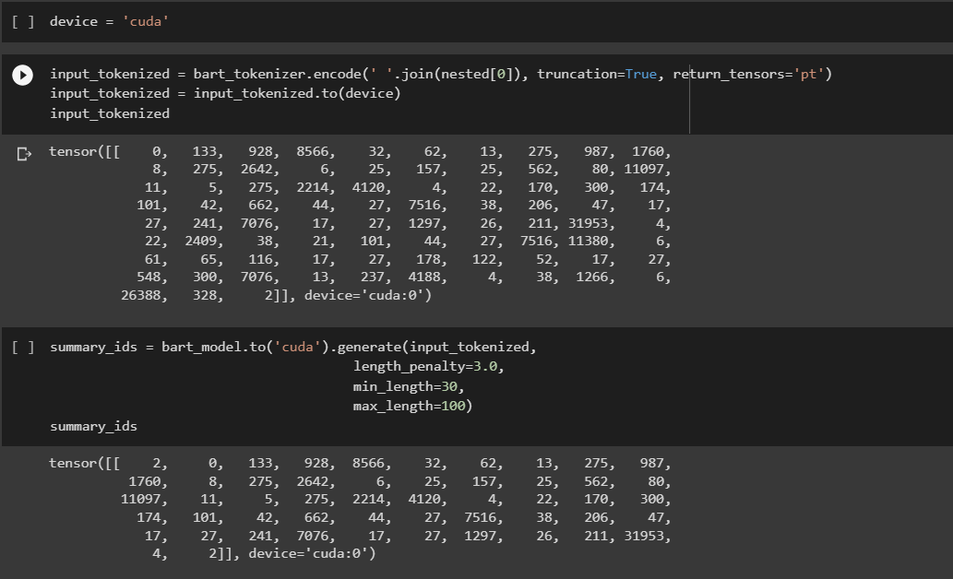
Tokenization:
Words of the paragraph are tokenized for efficient text summarization process.

Slide 12
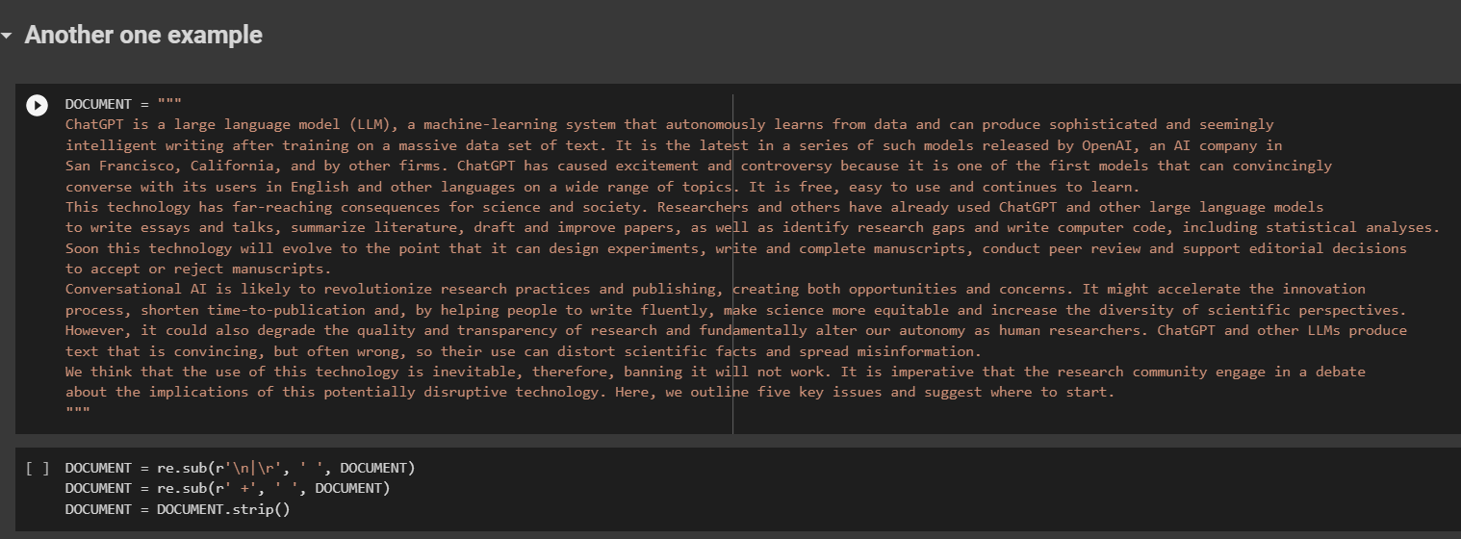
Example:

Slide 13
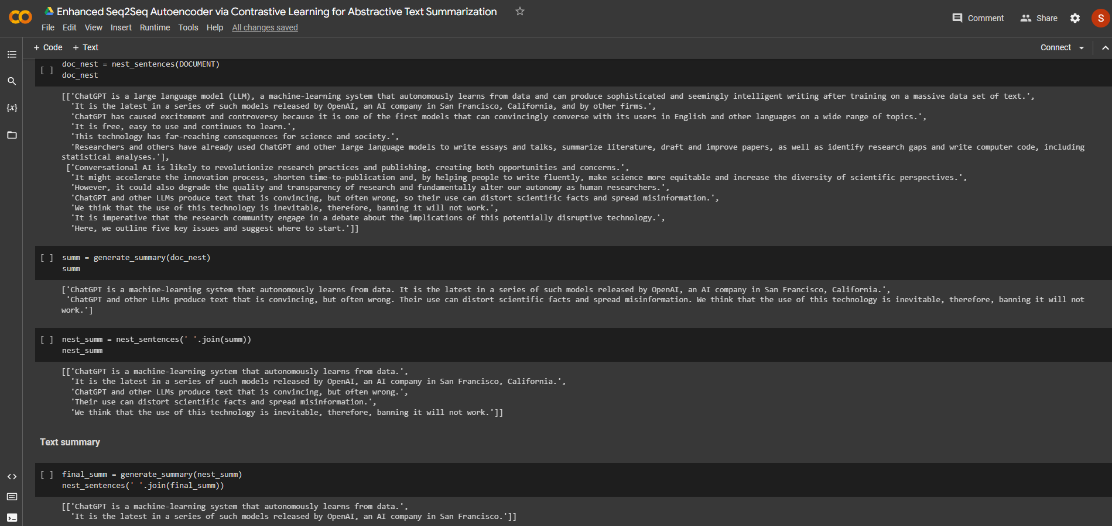

Slide 14
Github Link:
https://github.com/sayak-1108/Abstractive-Text-Summarization-using-BART

Slide 15
References:
https://huggingface.co/docs/transformers/model_doc/bart
https://arxiv.org/abs/1910.13461
https://paperswithcode.com/method/bart
https://youtu.be/Y2wrtZPrct8

Slide 16

THANK YOU

